Slide 1

Medical Device Single Audit Program Overview & Update
Neil A. Mafnas, CDR, USPHS
International Affairs Team
Center for Devices and Radiological Health
U.S. FDA

Slide 2


Medical Device Single Audit Program (MDSAP)
Regulatory Authorities (RA)
MDSAP
Interface MDSAP - Other RA Regulatory Processes
Assess
and Recognize
Share Audit Report
Other Info
Regulatory
Decisions
Auditing Organizations (AO)
(16 total)
Audit and Certify
Manufacturers
(>6500 individual sites
worldwide)

Slide 3

“The goal of the MDSAP is to provide for more effective, efficient and less burdensome regulatory oversight of the quality management systems of medical device manufacturers.” （SOC of MDSAP)

Slide 4







Other Membership
Observers |  | Affiliates
European Union |  | Argentina
United Kingdom |  | Israel
World Health Organization |  | South Korea
 |  | Singapore

Slide 5















Auditing Organizations
Authorized | Recognized | Application Received

Slide 6
MDSAP Overall Numbers
Facilities: 6,558
Certificate Holders: 5,090
From 2018-2022
Audit Reports Submitted: 17,625
Audit with at least one NC: 10,528 (60%)
Nonconformances: 37,994
5-Day Notice Audit Reports: 165
Public Threat Flag: 7
Fraudulent Activity Flag: 1
*Data as of 1/30/2023

Slide 7
MDSAP Participating Facilities

Slide 8
MDSAP Sites by Country

Slide 9
Audit Reports Received by Jurisdiction
Jurisdiction | 2018 | 2019 | 2020 | 2021 | 2022 | Total
Australia | 1797 | 2831 | 3311 | 3335 | 1695 | 12969
Brazil | 1576 | 2351 | 2715 | 2782 | 1415 | 10839
Canada | 2335 | 3767 | 4330 | 4261 | 2270 | 16963
Japan | 1540 | 2287 | 5611 | 2699 | 1301 | 10438
US | 2205 | 3511 | 487 | 4116 | 2214 | 16133

Slide 10
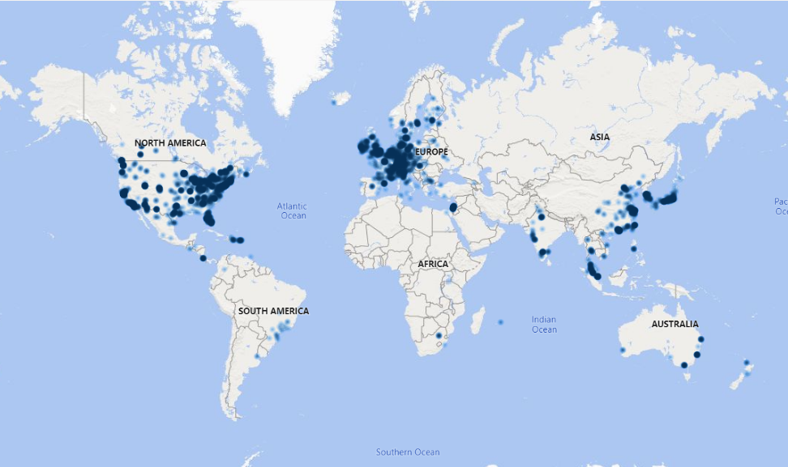
MDSAP Participant Where are They?

Slide 11
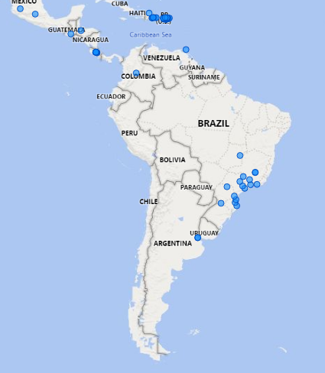
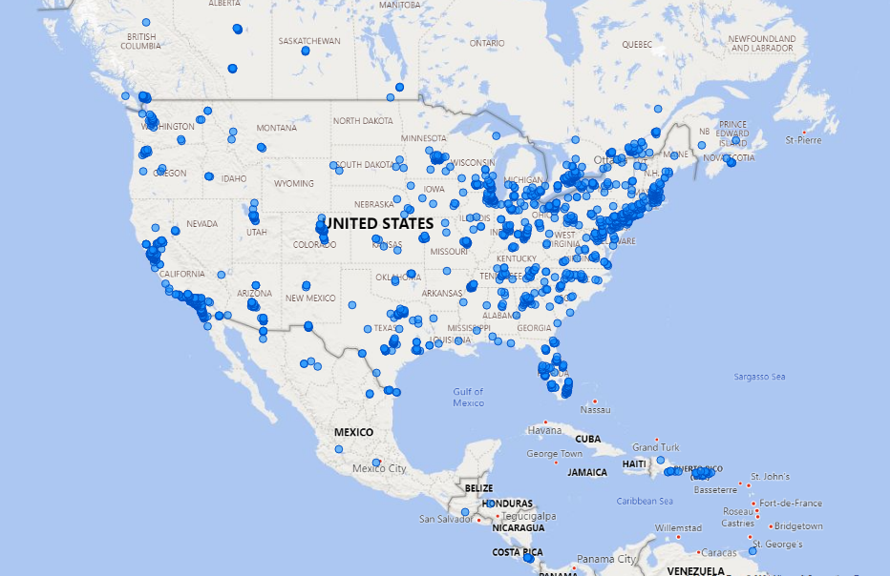
MDSAP Participant Where are They?
Notes:
.

Slide 12
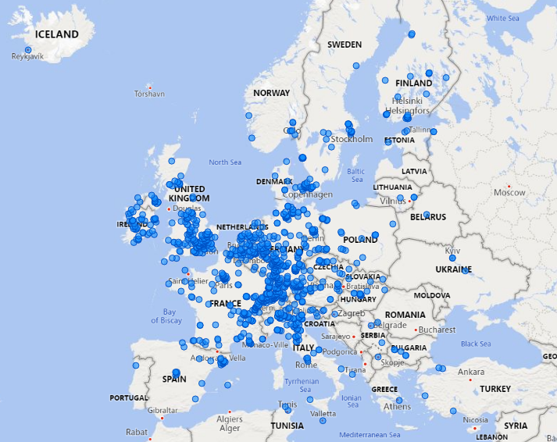
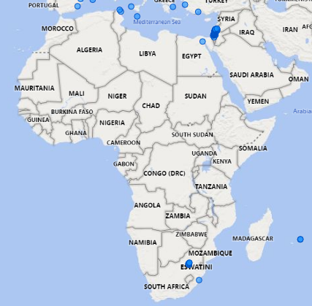
MDSAP Participant Where are They?

Slide 13
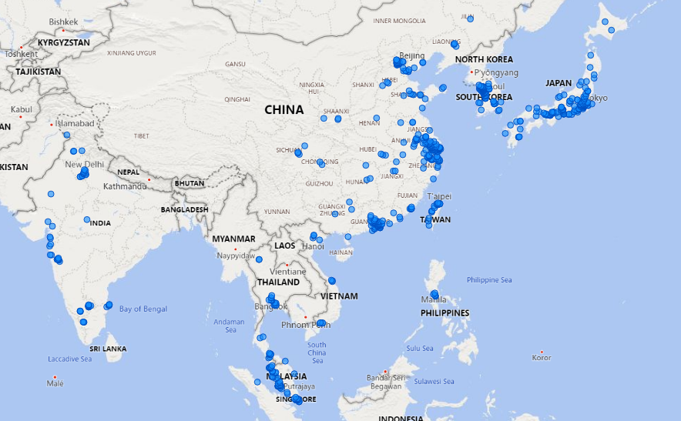
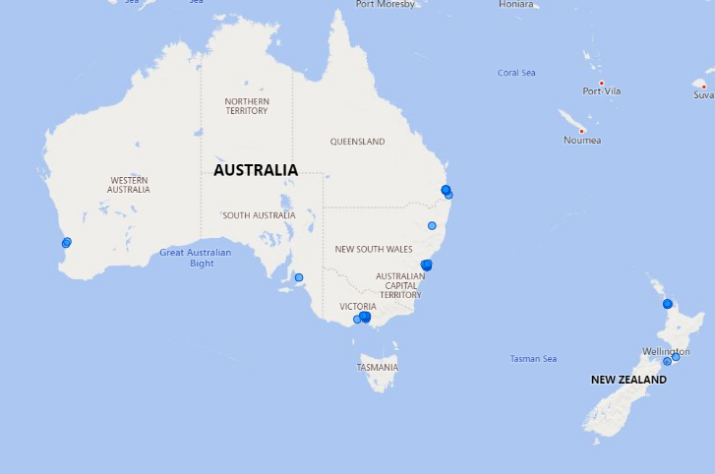
MDSAP Participant Where are They?

Slide 14
2022 Accomplishments
24 Assessments of Auditing Organizations
2,397 Audit Reports Submitted
528 New MDSAP Sites
Transition of the MDSAP IT Portal from PAHO to FDA
Mid-Year and End of Year Annual Forum
Addition of Israel as Affiliate Member

Slide 15
2023 Activities
Improve documentation of nonconformities in audit reports
Launch Pilot to permit hybrid/remote audit practices in a post-pandemic world
2023 Annual Forum(s)
Publish MDSAP Roles & Responsibilities Document (completed 1/6/2023)

Slide 16
Features of the New Criteria
Escalation rule from Affiliate to Observer, Observer to RAC Member
Clarification of expected contribution per each membership category
MDSAP Membership Model
Contribution
3 years
2 years
Affiliate
Observer
RAC Member

Slide 17
Please send any questions to MDSAP@fda.hhs.gov

